Slide 1

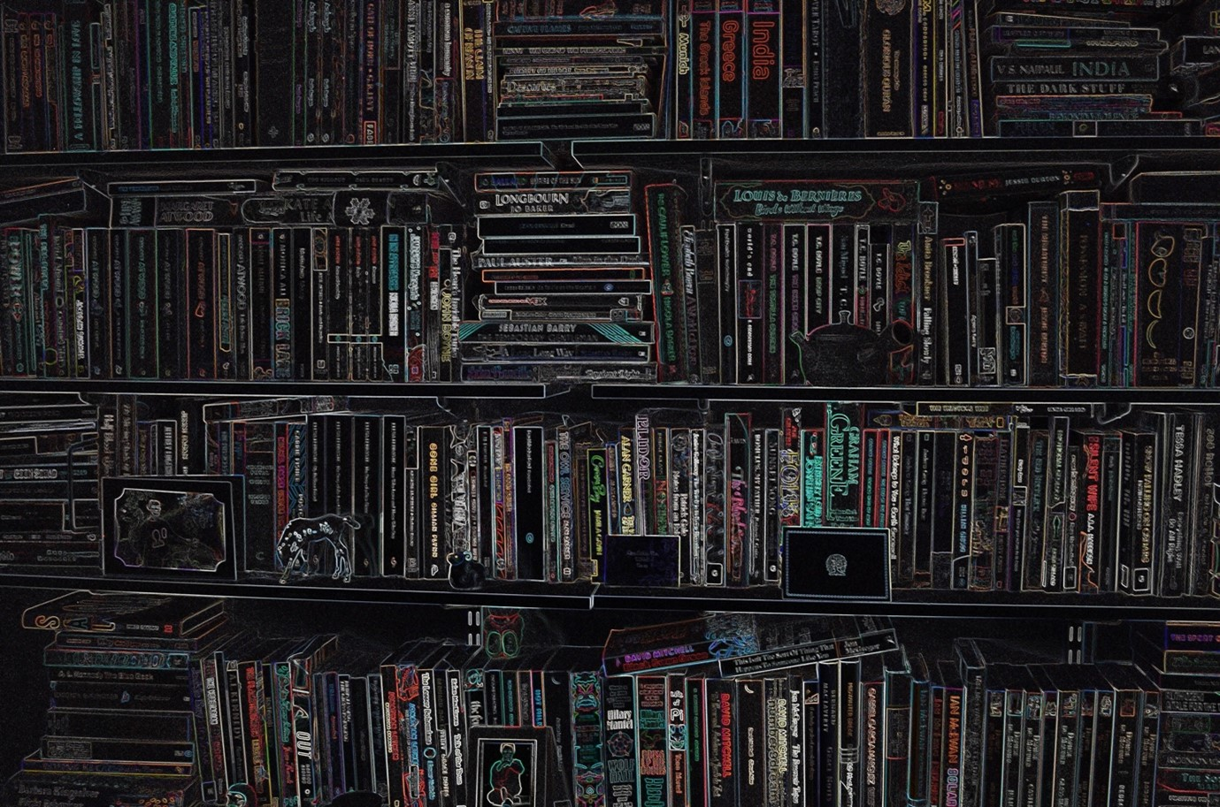




Five Types of Editorial Intervention
Alison Gray Editorial Services

Slide 2
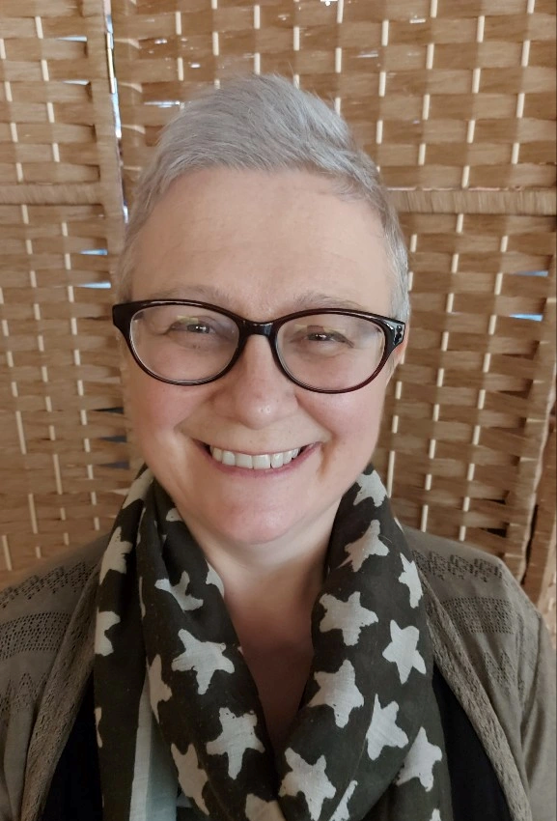
About Me
Developmental editor of fiction and nonfiction specializing in memoir, romance, general fiction, business, self-help, and children’s literature
Member of Chartered Institute of Editing and Proofreading (CIEP) and co-ordinator of Glasgow group
Qualified through the Publishing Training Centre, Chartered Institute of Editing and Proofreading, and Liminal Pages
Published and performed writer of fiction and drama. New Writers Award recipient for fiction

Slide 3
The Five
Coaching / Mentoring
Developmental Editing
Line Editing
Copyediting
Proofreading

Slide 4
Coaching / Mentoring
What is it?
The ‘infinite sea of ideas and inspiration’ view. Can include encouragement, guidance, deep-digging on concepts, and accountability. Early stages of a project.
What should I expect?
1-2-1 sessions that may be free-ranging or focused on submitted material. Coaches may offer one-off sessions or programs from three months to a year or more. Coaching questionnaire.
Coaching Questions
What do you want to explore? Who are your audience? What POV is the best for this? Would two different timelines be a good way to tell this story?
What do I look for in a coach / mentor?
Genre knowledge. Connection. Qualifications (CIEP, EFA, Author Accelerator). Experience

Slide 5
Developmental Editing
What is it?
Book and chapter view. Also called ‘big picture’ editing. It looks at narrative structure, plot, character arc. It may also analyse show/tell balance, tone/voice, and POV – if these are having a ‘whole book’ effect. Early to mid-stage of a project.
What should I expect?
To hand over a completed manuscript. Editors offer different levels of intervention. Generally, a Full Developmental Edit will include an editorial report, and a commented-on manuscript. A Manuscript Assessment is the editorial report alone. More editors are offering verbal feedback assessments using video calls or in-person meetings. The editor should help the writer solve any issues found. Client questionnaire.
Developmental editing questions
Is there tension? Is there emotional engagement? What questions does the reader ask as they read? Is there character change? What is the story about? What is the climax?
What do I look for in a developmental editor?
Genre knowledge. Connection. Qualifications from national organisations (CIEP, EFA, Club Ed Freelancers) and from editors specialising in teaching editing (Liminal Pages). Experience and recommendations.

Slide 6
Line Editing
What is it?
Paragraph, line, and word view. Areas covered are psychic distance, POV, show/tell, dialogue tags and beats, rhythm and repetition, consistency of physical elements, meaning and clarity.
What should I expect?
Partial or full manuscripts can be worked on. Manuscripts are marked up with changes suggested in Track Changes and Comments. Each editor has a level of intervention they are comfortable with; some editors will change writing others are more conscious of the author’s creative decision. There may also be a short editorial report summarising authorial tendencies. Sample line-edits are often offered.
Line Editing questions
Does this line make sense? Is that the right word? Is the character voice consistent (throughout and with the character)? Is this adverb needed? It there too much telling (or showing) here? Is that head-hopping? Is that a cliché?
What do I look for in a line editor?
Genre knowledge (sometimes). Does the sample edit intervene at the right level? Qualifications from national organisations (CIEP, EFA, Club Ed Freelancers) and from editors specialising in teaching editing (Liminal Pages).

Slide 7
Copyediting
What is it?
Line and word view. Grammar, spelling, punctuation, capitalisation, use of italics, consistency of physical elements, consistency in dialogue formatting. Style sheet choices and adherence.
What should I expect?
Partial or full manuscripts can be worked on. Manuscripts are marked up with changes suggested in Track Changes. Comments are used for queries and ambiguities. Editors may wait for answers to these queries before completing the edit. An agreed-on or created style sheet. Sample copyedits are often offered.
Copyediting questions
What is the style for dashes? If it is May, why are there daffodils? Were her eyes blue in chapter three? Is that how we spell Linnaeus? Should that be in italics? Is it ‘toward’ or ‘towards’? How should I spell ‘ok’?
What do I look for in a copyeditor?
Qualifications (CIEP, EFA, PTC). Does the sample edit intervene at the right level? Familiarity with your English.

Slide 8
A Fiction Style Sheet
References Used
Conventions Used
Character
Setting
Timeline

Slide 9
Proofreading
What is it?
Word and space view. Grammar, spelling, punctuation, capitalisation, use of italics, style sheet adherence. Visual impressions of manuscript.
What should I expect?
Your manuscript should be as close to perfect as possible, and the style sheet should be there for reference. Most proofreaders work in PDFs though many will work in Word. As proofreaders are looking at the shape of the text on the page, there is no room for large changes.
Proofreading questions
How is this spelled in the style sheet? Is that an orphan / widow. Should this French word be in italics? Is this a typo? Are those the dashes we are using for that?
What do I look for in a proofreader?
Qualifications (CIEP, EFA, PTC, Publishing Scotland)

Slide 10
Bibliography
Editorial Organisations
Strathkelvin Writer's Page | alison gray editoria

